Slide 1
Reunification of Adolescents
Jack A. Apsche, Ed.D., ABPP
October 21, 2010
Washington, D.C.

Slide 2
Reunification of Families in the District
How do we bring adolescent sexual offenders home to the District?
What does “successful treatment” look like for juveniles?
What is victim and offender reunification?
How does the family help?

Slide 3
Services Needed for Juvenile Sexual Offenders in the District
Assessment
a) abuser
b) victim
C) family
2) Outpatient Treatment
a) abuser
b) victim
C) reunification
D) family

Slide 4
Models of Treatment
Types of Assessments
1)Objective
a) Polygraph
b) ABEL VRT
c) Plethysmograph
2) Subjective
a) JSOAP-II
b) ERASOR
C) SORAG
d) MIDSA
3) Personality Assessment
a) MMPI 2
b) MCMI

Slide 5
Reunification
Abuser
Meets criteria?
2) Victim
Meets criteria?
3) Victim-abuser- neutral
4) Integrate both into family

Slide 6
Mode Deactivation Therapy
Individual
Family
Victim if over 14 if not, trauma focused CBT
MDT Assessments- look at x scores on all assessments
Give Blueprint for treatment

Slide 7
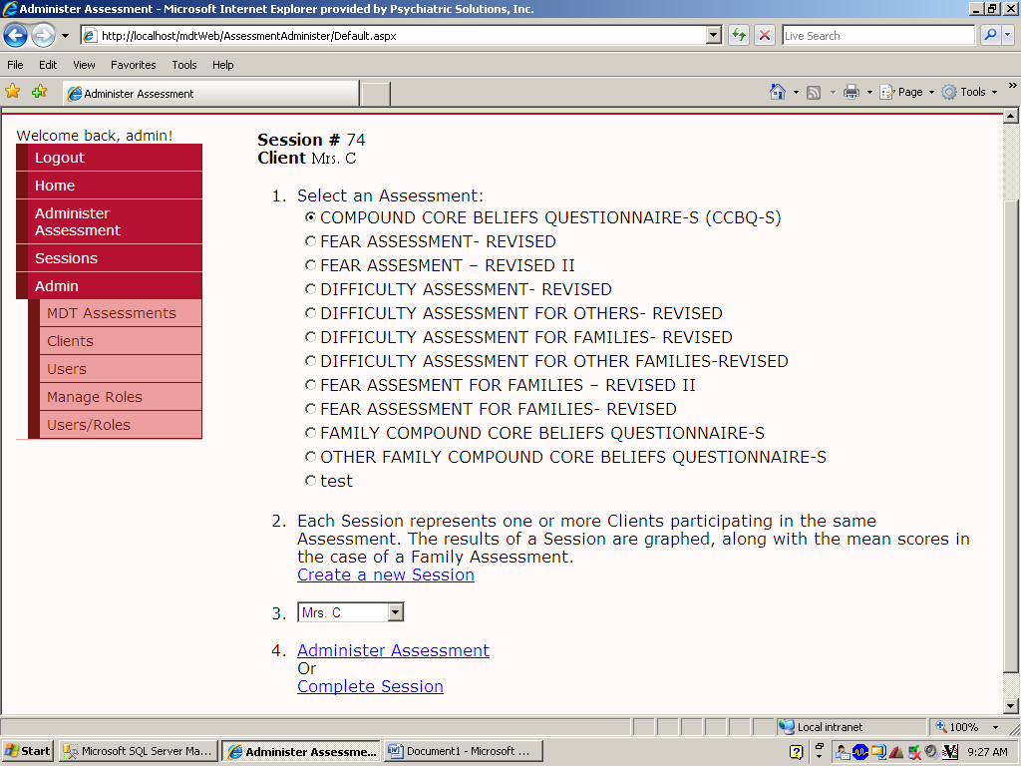
MDT Assessments

Slide 8
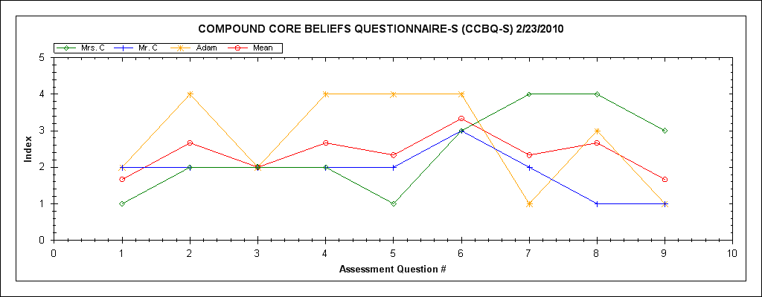
MDT Assessments
CCBQ-S

Slide 9
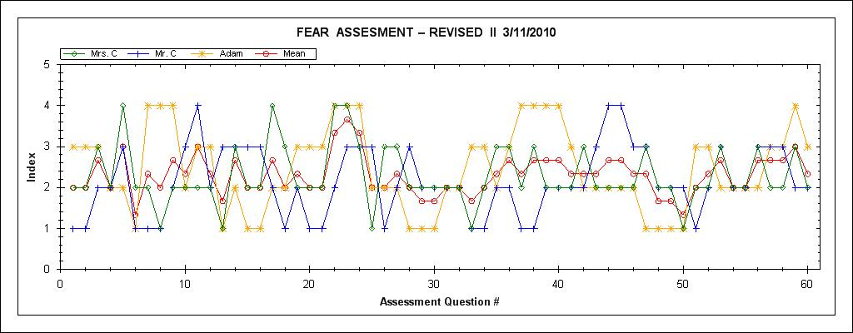
MDT Assessments
Fear Assessment- Revised II

